Slide 1
Community Update
Informational Meeting
Wednesday, August 22, 2018
GIEC Room 111

Slide 2
WELCOME!
Introductions and Refreshments (Dr. Midcap; President)
Residential Student Update (Director of Student Development)
Off-Campus Student Initiatives(Shelley Menear; Coordinator of Safety, Security, and Compliance)
Student Activity Initiatives (Brandon Jackson; Student Activities Manager)
Pedestrian Safety Initiatives (Shelley Menear; Coordinator of Safety, Security, and Compliance)
Reporting Mechanisms (Shelley Menear; Coordinator of Safety, Security, and Compliance)
Other Items (Dr. Midcap; President)
Questions

Slide 3
Introductions
Please introduce yourself, stating name and affiliation (homeowner, business or organization, or if you are a private landlord/property manager).
Notes:
Garrett College Staff, Administration and Board
Agency and community representatives
Local community participants

Slide 4
Residential Student Update
Housing Requirements
Background check has always been required
New requirements for living on campus
Hall Improvements
Garrett Hall(painting, carpet)
Laker Hall (new couches, painting)
IT improvements
Advisor in Residence
Notes:
Background check has always been required (criminal/court records & social media search)
New requirements for living on campus (minimum GPA, floor score on placement test)
Garrett Hall improvements (painting, carpet), Laker Hall improvements (new couches, painting)
IT improvements with funding from ARC grant
Advisor in Residence – focus on academic success, tutoring

Slide 5
Off- Campus Initiatives
Notes:
In Fall of 2017, College updated its Student Code of Conduct to include a more extensive focus on off-campus behavior to address concerning behaviors that had been reported in the past. The College works closely with property managers and landlords to have an idea of where students are living off campus and working with local law enforcement to address any concerns. Off-campus students are emailed at the beginning of each semester reminders about being a successful community member.

Slide 6
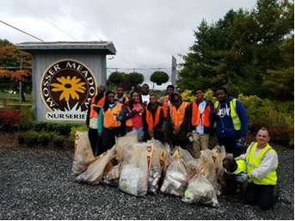
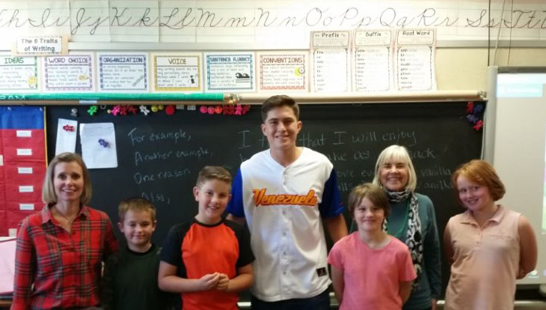
Student Activity Initiatives
Welcome Week
Welcome to Garrett County Lunch
Mentor Program
Intramurals Sports
Community Service Opportunities

Slide 7
Pedestrian Safety Initiatives
Notes:
The College has teamed up with the Maryland State Highway Administration to increase its pedestrian safety campaign efforts. The SHA provides the College with a variety of materials to use throughout the year for education and awareness programming. Additionally, the College is working with a variety of community partners to explore opportunities to install a walking trail on and near campus that will aid in safety efforts.

Slide 8
Reporting Mechanisms
Criminal violations
Contact Law Enforcement
Emergencies dial 9-1-1
Non-emergencies call
MSP at 301-387-1101
Sheriff’s Department at 301-334-1911
Concerns involving students or related to the College
Contact Campus Security
Email: security@garrettcollege.edu
24 hour Security: 240-321-5799

Slide 9
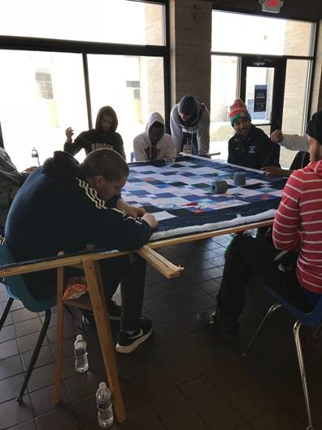
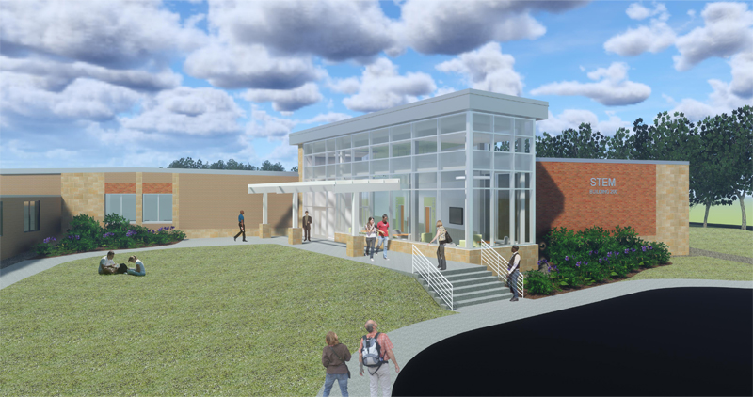
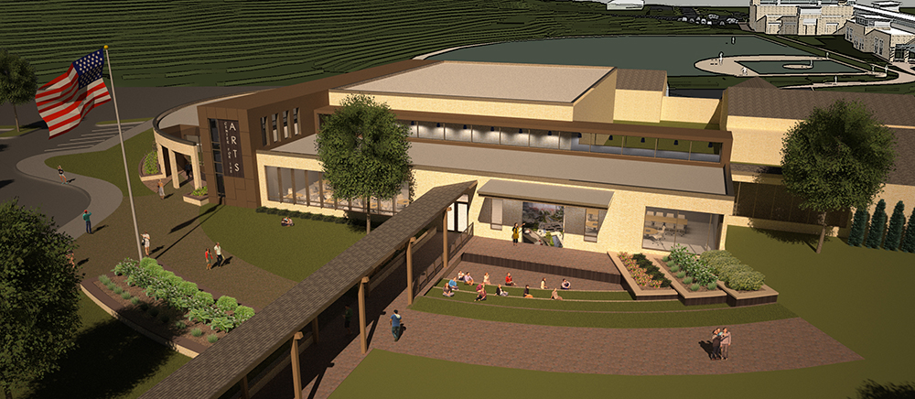
Other Updates
Community Partnerships
Capital Projects
Key Calendar Dates (handout)
Future Communication
Notes:
Community Partnerships
K-12
SING
Chamber of Commerce
Service projects
Capital Projects – STEM and CEPAC
Key Calendar Dates - handout

Slide 10
Questions?
THANK YOU FOR COMING!

