Slide 1
Student Guide to Self-Registration
Beginning in April 2019, students will self-register for classes online. This PowerPoint is designed to help you understand this new process.

Slide 2
What is Advising?
Garrett College prides itself on a rich advising structure that facilitates student learning and growth. The majority of students experience three distinct phases of Academic Advising at Garrett College:
New Student Advising – a student’s first advising experience at GC, usually during the summer or winter months, registers for first semester of classes
AASC Advising – a student is assigned an AASC advisor to help navigate them through the first semester or two at GC, talks about career goals and life goals, registers for classes
FACULTY Advising – a student is assigned a FACULTY advisor specific to his or her program once he or she reaches 12 college level credits and a 2.0 cumulative GPA, talks about career, life, transfer goals and registers for classes

Slide 3
Best Chance Advising
Best Chance Advising is the month-long period before final exams each fall and spring semester in which students may register for classes for the upcoming semesters.
This period of time is the BEST CHANCE for returning students to get the classes they need, at the times they want, with the instructors they prefer.
This period is strategically scheduled to take place before new entering students will have the opportunity to register for classes.

Slide 4
Best Chance Advising Spring 2019
Monday, April 8 – Wednesday, May 8
Students may register for classes after this time, however:
Faculty advisors may not be available,
New entering students will begin to register for classes,
Classes will likely begin to fill up.

Slide 5
What is Self-Registration?
Self-registration simply means that students register themselves for classes (as opposed to the advisor registering the classes into the system for the student).
This is an advising practice that many schools have used for years, even decades.
Students are still required to meet with the advisor FIRST in order to receive the much-needed guidance.
If a student can shop on Amazon, they can self-register for classes.

Slide 6
Benefits of Self-Registration
Empowers students to take greater ownership of their academic journey
Saves Advisor from serving as a data entry person for the course registration portion of the advising appointment
Eliminates student paperwork by automating the paper trail
Spares Records & Registration the filing of tedious document hard copies
Ushers Garrett College into the 21st century ☺

Slide 7
Best Chance Advising with Self-Registration Overview
Advising activities will only change slightly with the launch of student self-registration. The general process will look like this:
MEET – student will sign-up for appoint, meet with advisor, discuss desired classes
SELF-REGISTER – student leaves appointment and self-registers for classes within 48 hours
VERIFY – advisor reviews and approves student courses within 48 hours, student verifies course schedule is accurate
Since the advisor will no longer be doing the data entry, this allows him or her more time during the appointment to provide intentional and focused advisement.

Slide 8
STUDENT INSTRUCTIONS
On the next several slides you will find detailed student instructions for the Best Chance Advising and Self-Registration Process.
These instructions are also outlined in the Student Guide to Self-Registration; available in print and online.
Simplified instructions are available on the Student Self-Registration handout.

Slide 9
MEET
Sign up for an appointment on your advisors door. Before the appointment, use the MyGarrett portal to do the following:
Complete Registration Agreement (for each semester you intend to register for)
The Registration Agreement form is located in the Course Registration area of the Student Tab. Be sure to select the appropriate term in the gray shaded area. If you are registering for more than one term (i.e. summer and fall), you will complete a Registration Agreement for each term.
Complete Personal Information Update (required for fall and spring only)
The Personal Information Update form is located in the Course Registration area of the Student Tab. Complete all areas as accurately as possible.
Use the Course Search* area to find the classes you want to take. Have a schedule of classes written down and ready to discuss during the appointment. *Note – you will not be able to view the course schedule when logged into the MyGarrett portal until you complete the Registration Agreement and Personal Information Update. You may still view the course schedule while not logged in.

Slide 10
MEET
Also, take care of any HOLDS you may have on your account. You will not be able to self-register for courses with a HOLD.
Go to your scheduled advising appointment. During the appointment, discuss your academic plan, including the classes you wish to take next semester, with your advisor.
If you need to register for any courses that you are repeating for a 2nd time or courses that require special permission, you must do this in-person with your advisor.
You MUST meet with your advisor to receive registration clearance.

Slide 11
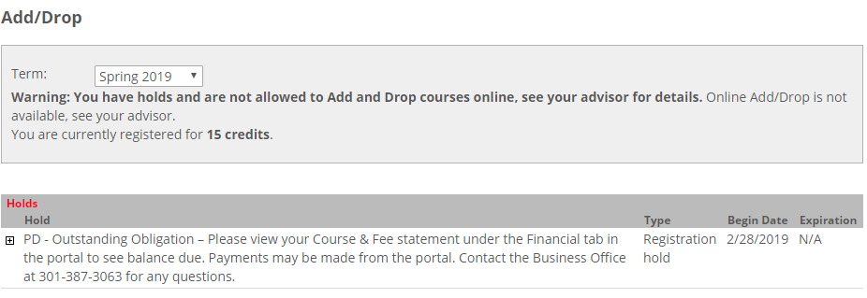
HOLDS
Students will not be able to self-register for classes with a HOLD.

Slide 12
SELF-REGISTER
After your advisor meeting, you have 48 hours (2 days) to self-register for courses. After a period of 48 hours, registration clearance will be removed and you will need to meet with your advisor again to receive clearance. Be sure to register for classes AS SOON AS POSSIBLE after your advisor appointment to avoid classes filling up and clearance removal.
Student self-registration takes place on the MyGarrett portal.
HOW TO SELF-REGISTER
Log into My.GarrettCollege.edu (At this point, you should have already completed the Registration Agreement and Personal Information Update. If you have not, do them now.)
Register for courses – see next TWO slides.
If you need help during the self-registration process, visit the AASC in room 519 or the Tutoring Center in the library.

Slide 13
ADD BY COURSE CODE
There are two ways to register for courses in the Course Registration Area.
Add by Course Code – allows you to quickly add courses you had previously identified by the course code (i.e. SPC101-02). If you and your advisor prepared a full schedule in advance, this is the best option.
Check the term in the gray box; default is always fall or spring. If you plan to register for a summer or winter course, do those first, then proceed to fall or spring using these same steps.
Click the Add by Course Code tab.
Type the full index code, including the section number, for your first course into the box (SPC101-02 – do not add the space between three letters and three numbers, system will automatically populate courses as you type, select your course as identified by the last two numbers or section number).
You may add courses one by one or all at once.
Click Add Courses.

Slide 14
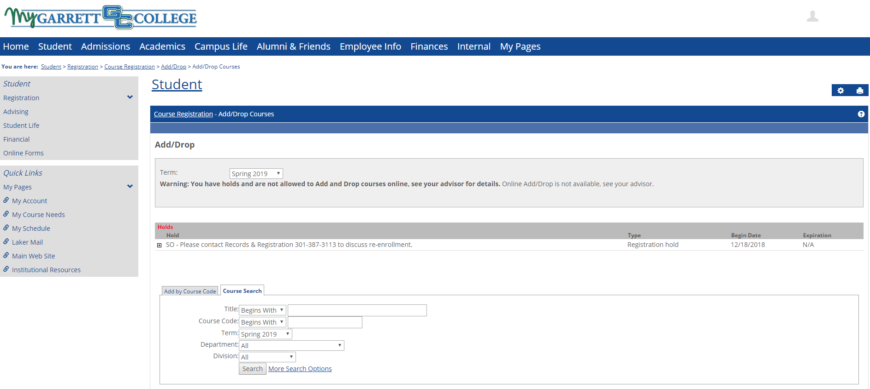
ADD BY COURSE CODE

Slide 15
COURSE SEARCH
There are two ways to register for courses in the Course Registration Area.
Course Search – allows you to filter and search through the entire course schedule to find the courses you wish to choose. Use Course Search function of Course Registration area to find, select, and add your desired courses to your schedule.
Check the term in the gray box; default is always fall or spring. If you plan to register for a summer or winter course, do those first, then proceed to fall or spring using these same steps.
Use the various Course Search options (or select More Search Options for more) to find the classes you wish to register for. You can search by course title, course code (SPC 101 – must add the space between three letters and three numbers), time of day, day of the week, and more.
When you have identified a course you wish to register for, click the Add Course box to the left of the Course Code and click Add Courses at the bottom of the screen. You may also click the blue course code link and click Add Course on the next screen.
Proceed to find and register for all of your desired courses in the Course Search area.

Slide 16
COURSE SEARCH

Slide 17
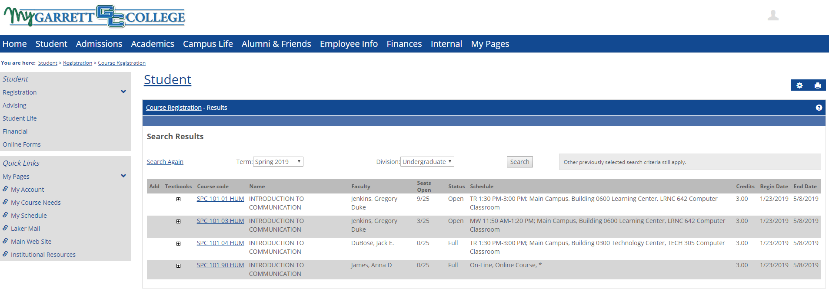
COURSE SEARCH

Slide 18
REGISTRATION MESSAGES
Once you have clicked Add Courses, you will see status message at the top of the next screen. These messages may include a course add confirmation, course add warning, or an error message. Pay close attention to all status messages. Examples:
Confirmation:
Successfully added
Warning:
Financial aid may not pay for this course, it is not in your program requirements and will not count towards financial aid enrollment status. See your advisor for more information.
This course is a repeat of a previous registration. Financial aid may not pay for repeated courses.
This course if full or students are already waitlisted. You are not fully enrolled in this course until the Office of Records and Registration notifies you of a seat opening and you accept.
Error:
This registration exceeds the number of times you are allowed to repeat this course. See your advisor to request authorization to repeat.
Permission of instructor is needed. See your advisor for more information.
Adding this registration would create an overload (greater than 18 credits). See your advisor to request authorization.
A prerequisite for this course has not been met. See course description for prerequisite details.
You do not have permission to Drop courses. See your advisor for more information.

Slide 19
VERIFY
Once you’ve registered for your classes, your advisor will then approve your course selections within 48 hours. Courses that have been approved by advisor will appear as Current on your schedule and courses that are awaiting advisor approval will appear as Reserved. If your courses are not approved after a few days, contact your advisor.
You may register for additional courses through the end of the add/drop period; however, you may not drop courses. To drop courses, you must see your advisor.

Slide 20
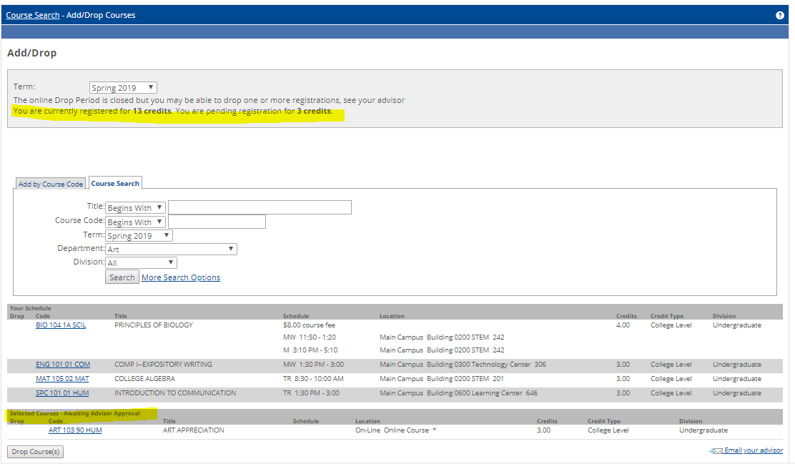
VERIFY
Courses still waiting for Advisor approval
Advisor has approved these courses

Slide 21
FAQ
Can I register myself for classes online?
YES, but you must first meet with your advisor.
How do I know who my advisor is?
Look under the Student tab on your MyGarrett portal.
How do I know what classes to take?
Use your Advising Worksheet on your MyGarrett portal, the College Catalog, and your advisor.
How many classes can or should I take?
Students may register for between 12-18 credits; somewhere around 15 credits per semester is recommended.
How do I register for classes online?
Read the instructional guide.

Slide 22
FAQ cont.
When should I register for classes?
Within 48 hours after meeting with your advisor.
Can I drop classes online?
No, you must see your advisor to drop or withdraw from a class.
Can I change my major online?
No, you must see your advisor to change your major.
What if I need help?
See the AASC in room 519, call 301-387-3715, or visit the Tutoring Center in the Library. Resources are also available in the MyGarrett portal (login, click Student tab, scroll down to Useful Forms area).

Slide 23
IMPORTANT DATES & ACTIVITIES
NOW
Start thinking about the classes you wish to take next semester.
Do you want to take any summer classes?
Take care of any HOLDS they may have.
BEGINNING APRIL 1
Sign up for an advising appointment on your advisor’s door.
Use the MyGarrett portal to look for the classes you wish to take; map out a class schedule.
BEGINNING APRIL 8
Meet with your advisor during your scheduled appointment.
Self-register for classes!

Slide 24
RESOURCES
Several resources are available to you in the Tutoring Center:
Student Guide to Self-Registration (detailed instructions)
Self-Registration handout (concise instructions)
Registration Worksheets (to pre-plan course schedule)
Advisor Contact Information Sheets (name, phone number, email, office number)
For questions, see Ashley or Nick in the AASC.

